Slide 1
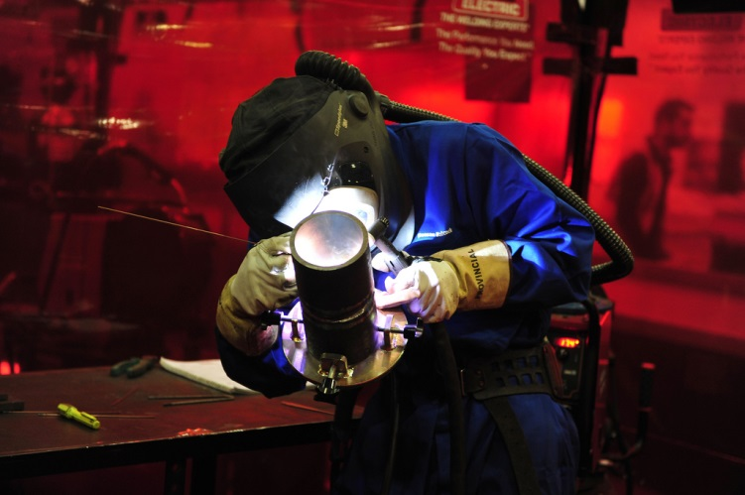
New Welding Apprenticeship Overview 2017

Slide 2
Welding Trailblazer Start Point
The government asked Employers to define what they want in an apprenticeship.
Consequently a Working Group was setup in Oct 2014 to help define what Employers believed was needed in a Welding Apprenticeship.
They found, after some investigation, that there were 43 different types of welding apprenticeships with different levels of standards in England at the time.
So employers asked themselves “What do we want in a welder?”
The answer was simple –
the welder needs to be able to pass a trade test and get welding.
The trade test is a coded weld test in accordance with EN, AWS or ASME (American Society of Mechanical Engineers) standards to ensure they are working to the same level as everyone else.
The aim is to
“give employers the confidence that welders, when completing their apprenticeship, have the required competencies regardless of where they were trained and by whom they were assessed”

Slide 3
Two Apprenticeship Standards
The two page definition of the apprenticeship is very broad in definition to cover all sectors, there are two levels, these are;
Level 2 general Welder (Arc Process)
General Welders are fully competent in manual welding using at least one arc process. General Welders are required in a number of sectors for example, the steelwork construction sector.
Link https://www.gov.uk/government/publications/apprenticeship-standard-welder-level-2
Level 3 Multi Positional Welder (Arc Process)
Multi-Positional Welders are fully competent in manual welding using at least one arc process in all welding positions. Multi-Positional Welders are required in a number of sectors for example, the oil and gas sector.
Link https://www.gov.uk/government/publications/apprenticeship-standard-welder-level-3
English & Maths requirements for the standard
Level 2 English & Maths at level 1 (minimum)
Duration : This apprenticeship has a typical duration of 18 months.
Level 3 English & Maths at level 2.
This equates to either a level C GCSE or the equivalent education obtainment
Duration : This apprenticeship has a typical duration of 38 months.

Slide 4
The levels are both based around these requirements
There are three areas to be assessed, these are;
A theoretical knowledge test
Multiple choice question papers
Generic questions relevant to all welders
Specific questions relevant to the theoretical module selected by the employer
A practical and oral examination
For level 2 – two practical tests and an oral examination
For level 3 – three practical tests and an oral examination
The welds need to be in the most difficult position for the level selected
The practical tests (codes) use different processes, positions and materials
The welding specifications are;
EN ISO 9606 (1 - 4)
ASME IX
AWS D1.1
A professional interview – End point assessment
This is used to determine the apprentice's knowledge relevant to their role
To assess the apprentice’s occupational behaviours meet the requirements specified in the Apprenticeship Standard

Slide 5
End Point Assessment
Part 3 must be carried out last.
In order to be successful, apprentices must pass all three parts.
Part 1 Theoretical Test
Part 2
a) Practical tests
b) Oral examination
Part 3 Professional Interview
Merit
Pass
Re-test (s)
Re-training
The apprentice must have the required level of English and Maths before starting the end point assessment.
The Apprentice must have undertaken sufficient training to be ready to attempt the end point assessment.
This can comprise of review meeting and a continuous on-programme assessment of knowledge, skills and behaviours. Records of these assessments should be kept and made available to the Assessment Organisation prior to the end-point assessment.
All parts of the end-point assessment shall be under the direct control of the Assessment Organisation.
The Assessment Organisation is responsible for ensuring that the equipment and facilities required for the end-point assessment are in place, regardless of where the assessment is carried out.

Slide 6
Skill Modules Option within the standards
Table 2
Welding Filler Material Groups | Welding Process(es)
 | TIG (GTAW) | MIG/MAG (GMAW) | MMA (SMAW) | TIG (GTAW) root & MMA (SMAW) Fill | FCAW
Carbon & Low Alloy steel (up to 4% total alloy content) | Module 1 | Module 6 | Module 11 | Module 15 | Module 19
High Alloy Ferritic /Martensitic Steels | Module 2 | Module 7 | Module 12 | Module 16 | Module 20
Austenitic Stainless Steels | Module 3 | Module 8 | Module 13 | Module 17 | Module 21
Nickel and NI Alloys | Module 4 | Module 9 | Module 14 | Module 18 | N/A
Aluminium & Al Alloys | Module 5 | Module 10 | N/A | N/A | N/A
Level 2
The employer selects Two options from the table, covering two welding positions (Down-hand, Horizontal, Vertical , Overhead). The scope of the specific part of the theoretical knowledge tests (Table 2) and the practical skill tests will be in accordance with the modules selected by the employer.
Level 3
The employer selects Three options from the table, covering all welding positions (Down-hand, Horizontal, Vertical , Overhead) in pipe or plate. The scope of the specific part of the theoretical knowledge tests (Table 2) and the practical skill tests will be in accordance with the modules selected by the employer.
The apprentice will be required to demonstrate that they have achieved the skill required for welding plate and/or pipe in all positions with the completed test pieces meeting the required levels of quality in accordance with the selected specification. The knowledge requirements are listed in the Apprenticeship Standard and more details may be found in References 1-6.

Slide 7
Modules Options (Level 2)
 | Welding Process Section (Duration) | MMA (SMAW) | TIG (GTAW) | MIG/MAG (GMAW) FCAW
A | General Theoretical Training (includes questions on Carbon and low alloy steels)
 | Basic welding equipment and processes (A.1-A.9 modules from IAB-089) (20 hours) | 55 minutes (40 questions)
 | Making weled joints (B.1-B.9modules from IAB-089) (18hours) | 40 minutes (36 questions)
B | Welding Process Specific Theoretical Training
 | MMA (SA.1-SA.3modules from IAB-089) (5 hours) | 10 min (10 questions)
 | TIG (ST.1- ST.3 modules from IAB-089) (5 hours) |  | 10 min (10 questions)
 | MIG/MAG/FCAW (SM.1-SM.4modules from IAB-089) (7 hours) |  |  | 15 min (14 questions)
C | Materials Specific Theoretical Training
 | High alloy steel (8 hours) | 20 minutes (16 questions)
 | Austenitic stainles steel (PSS.1-PSS.4 modules from IAB-089) (8 hours) | 20 minutes (16 questions)
 | Nickel (8 hours) | 20 Minutes (16 questions)
 | Aluminium (PAL.1-PAL.4 modules from IAB-089)(8 hours) | 20 minutes (16 questions)
Multiple choice examination papers
Suit the skill/knowledge of the modules selected
Examinations are conducted by the Assessment Organisation.
The next slide shows an example using these options

Slide 8
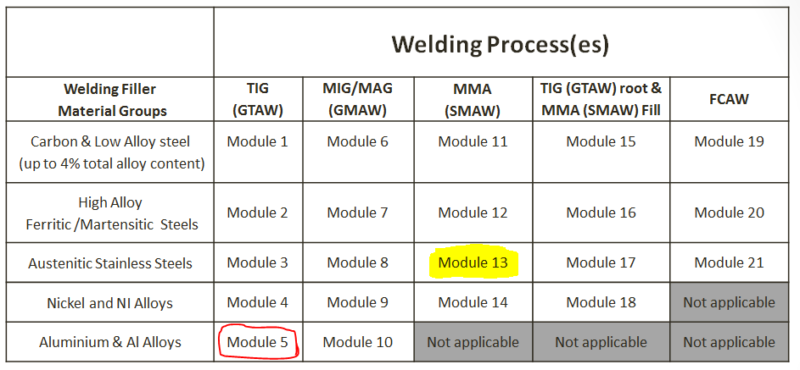
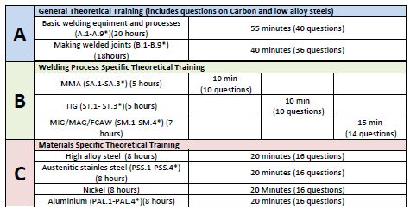
Module Selection Example
Table 1
If skill/knowledge module 13 from (Table 1) is selected,
the following would be the options for the apprentice
for each section:
A = ALL general theoretical training would apply
B = ONLY MMA (SMAW) specific theoretical training
would apply
C = ONLY austenitic stainless steel specific theoretical
training would apply
It is only necessary to pass Section A once, it is not repeated for the other skill/knowledge modules selected.
If another module selected from Table 1 was
module 5, then the apprentice’s other skill/knowledge
modules would be:
B = TIG (GTAW) specific theoretical training
C = Aluminium specific theoretical training
During the course of their training, it is recommended
that apprentices complete interim theoretical examinations, set by the Training Body using their own questions, based on the curriculum given in References 1 and 6, in order to prepare them for the final theoretical test.

Slide 9
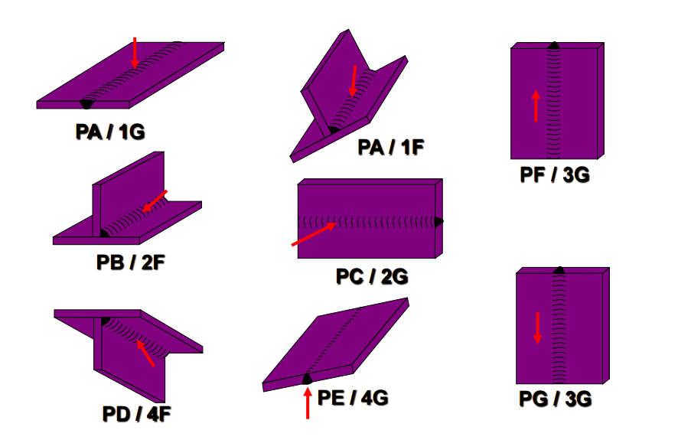
Welding Test Details
Down-hand or Flat Position
Vertical Position
The Apprentice will need to practice the welding position and material to gain enough skill to ensure they pass the practical part of their training. This can be achieved by taking a “code” test before the end of their apprenticeship. This ensures that, on reaching the end-point assessment, the apprentice has received the optimum preparation. This will also allow the apprentice to carry out production activities within the scope (range) of any practical tests already passed.
Horizontal Position
Welding Specifications
EN ISO 9606 1-4 Qualification testing of welders
AWS D1.1
ASME (Boiler and Pressure Vessel Code) section IX Welding
Note: BS 4872 – could be used but most employers might not accept this as the inspection requirements are much
lower than the other standards specified
Testing
Destructive and non-destructive tests for qualification testing of welders shall be carried out by qualified inspection personnel, in accordance with appropriate testing specifications.
Note: The PC etc. is from the EN ISO 9606 standards and the 2G etc. is from the ASME standard
Overhead Position
Welding Test Example in accordance with EN ISO 9606-1
10mm Carbon (mild steel) plate, single V Butt (groove) joint design, using TIG (GTAW) process in a horizontal PC (2G) position | There is one mandatory test required which is visual inspection, this is in accordance with ISO 17637. Then there are three optional tests of which one is compulsory. Radiographic testing according to ISO 17636 Bend test according to ISO 5173 Fracture test according to ISO 9017

Slide 10
Welding Test Details continued
Oral examination during the code test
During the course of the practical test, the Authorised Examiner will also be required to conduct an oral examination of the apprentice to assess the understanding of the activity they are undertaking along with the wider responsibilities of a welder. Examples are detailed in the Apprentice Standard.
A pass or fail result for the oral examination will be awarded by the Assessment Organisation’s Authorised Examiner.
professional interview
The professional interview will be attended by:
The Apprentice
An Authorised Examiner of the Assessment Organisation competent in conducting and deciding the result of the professional interview.
The Authorised Examiner is responsible for leading the interview and for making a decision on the outcome.
The professional interview will cover three areas:
1. Application of knowledge learned during the apprenticeship.
2. Role of the welder in industry.
3. Professional behaviours as listed in the Apprenticeship Standard.
Grading
The three parts of the assessment are scored and each part has a weighting, this is all defined in the assessment plan, an example is also given.
Knowledge test scored out of 100 with the pass mark set at 60, with a weighting of 20% overall
The practical test is a pass or fail and has a weighting in the overall assessment of 50%.
The oral examination is scored out of 100 with the pass mark set at 60, with a weighting of 15% overall
The professional interview is scored out of 100 with the pass mark set at 60, with a weighting of 15% overall

Slide 11
Assessment Organisation An Assessment Organisation seeking approval to conduct the end-point assessment for the Trailblazer Welding Apprenticeship will be required to develop a bank of examination questions which adequately test the knowledge requirements in the Apprenticeship Standard. The Assessment Organisation would also be required to show how it selects questions from their bank, in order to produce examination papers that comply with the structure in Table 2 and to ensure a reasonable spread of questions across the syllabus for each section.
Authorised Examiner & Assessment Organisation
Authorised Examiner
Assessment Organisations shall appoint representatives to act as Authorised Examiners. Authorised Examiners shall have independent evidence of competence in the role and responsibilities as defined by the standard.
Typically
International/European Welding Specialist, or
Certified CSWIP or PCN Welding Inspector, or
A1 Assessors with recent, relevant occupational experience and competence in the occupational areas covered by the Apprenticeship Standard and this Assessment Plan

Slide 12
Any Questions?
Useful links from the PDF for later
The Welding Institute webpage. A copy of this document can be found here IAB-089 r5-14 Part I International Welder Guideline | http://www.theweldinginstitute.com/education-and-development/uk-apprenticeships/trailblazer-welding-apprenticeships/
Apprenticeship standards | https://www.gov.uk/government/collections/apprenticeship-standards
Apprenticeship standard: welder - level 2 (approved for delivery) | https://www.gov.uk/government/publications/apprenticeship-standard-welder-level-2
Apprenticeship standard: welder - level 3 (approved for delivery) | https://www.gov.uk/government/publications/apprenticeship-standard-welder-level-3
Register of apprenticeship training providers | https://www.gov.uk/government/collections/register-of-apprenticeship-training-providers
Apprenticeship funding: how it will work | https://www.gov.uk/government/publications/apprenticeship-levy-how-it-will-work
Future of apprenticeships in England: guidance for trailblazers | https://www.gov.uk/government/publications/future-of-apprenticeships-in-england-guidance-for-trailblazers
Using the register of apprentice assessment organisations | https://www.gov.uk/government/publications/using-the-register-of-apprentice-assessment-organisations
A good welding positions poster can be downloaded here | http://www.voestalpine.com/welding/Services/Downloads
Requirements for the Certification of Welding Examiners (DOCUMENT No. CSWIP-WEX-23-13) | http://www.cswip.com/schemes/brazer-examiner/
Certification Scheme for Welder Training Organisations (CSWTO) | http://www.cswip.com/schemes/certification-scheme-for-welder-training-organisations/

